Slide 1
Fractures in the EGS Collab Testbed-2
Hari Neupane, INL
ghanashyam.neupane@inl.gov
February 27, 2023

Slide 2
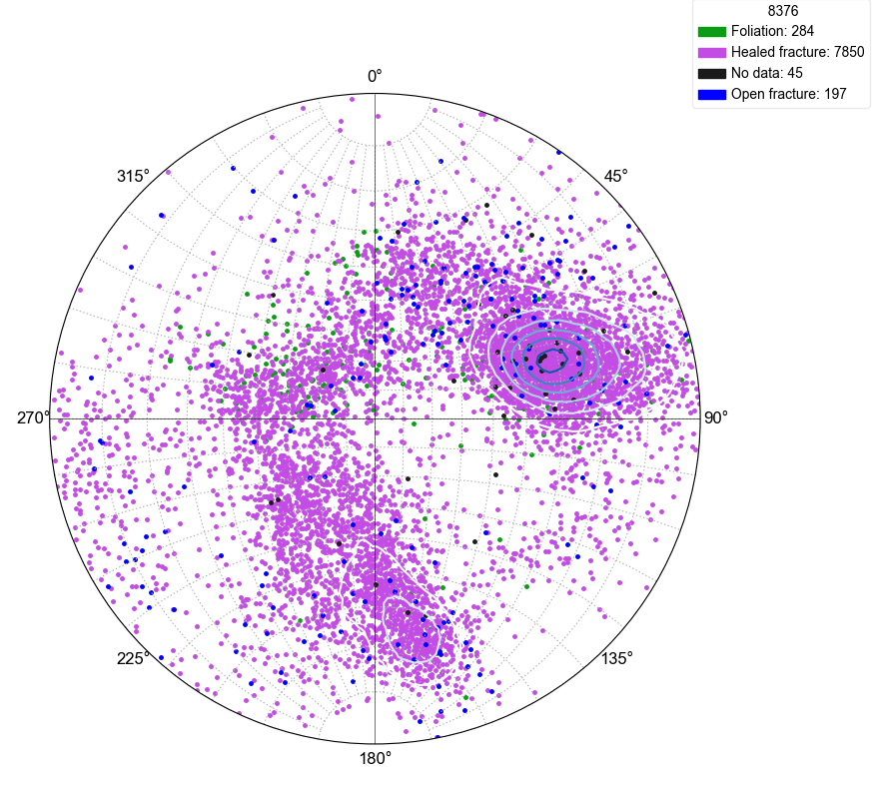
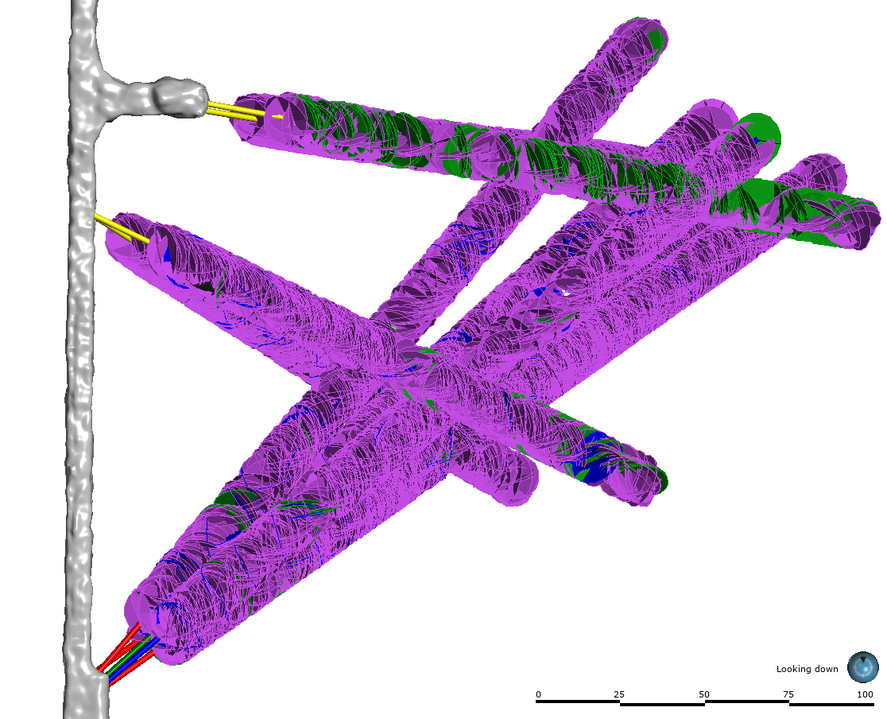
Fracture picks- Craig Ulrich
Now available for all boreholes
B)
A)

Slide 3
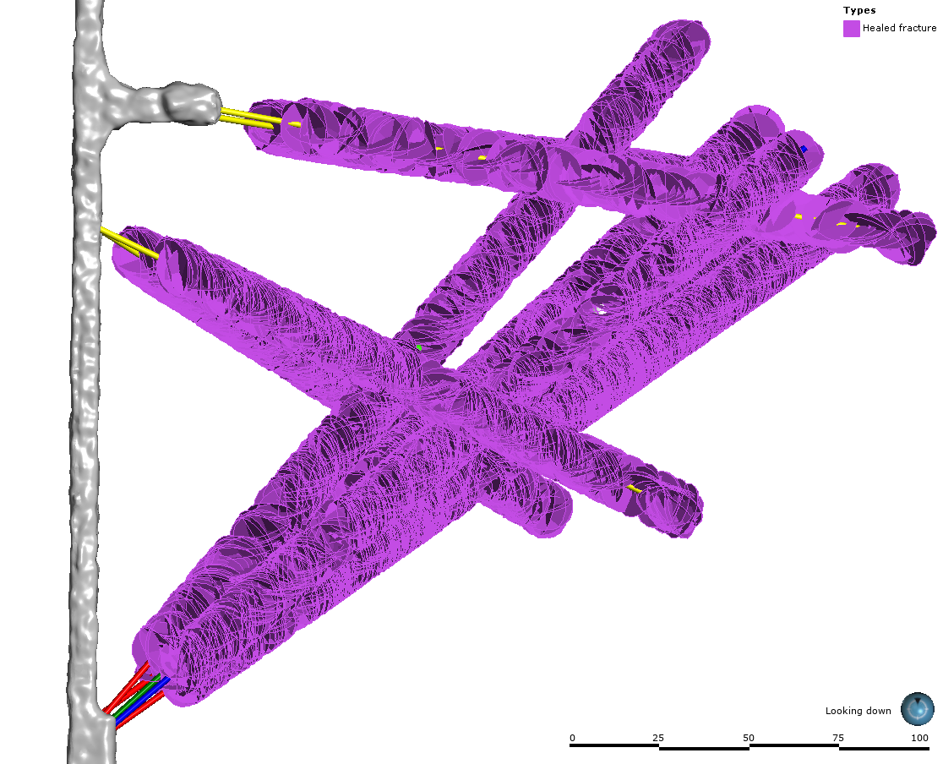
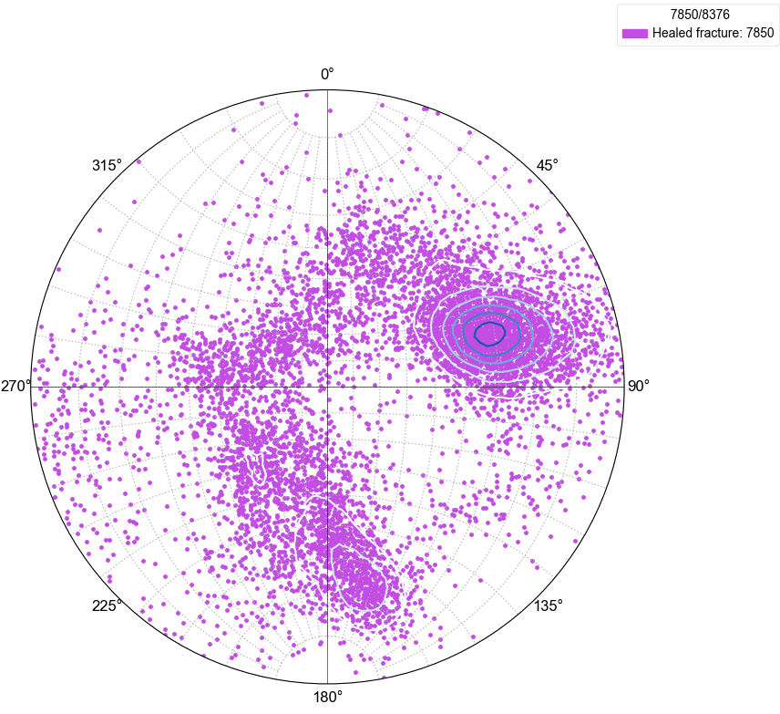
Healed Fractures
Pole: 31°/71°
Plane: 59°/251°
B)
Pole: 23°/171°
Plane: 67°/351°
A)

Slide 4
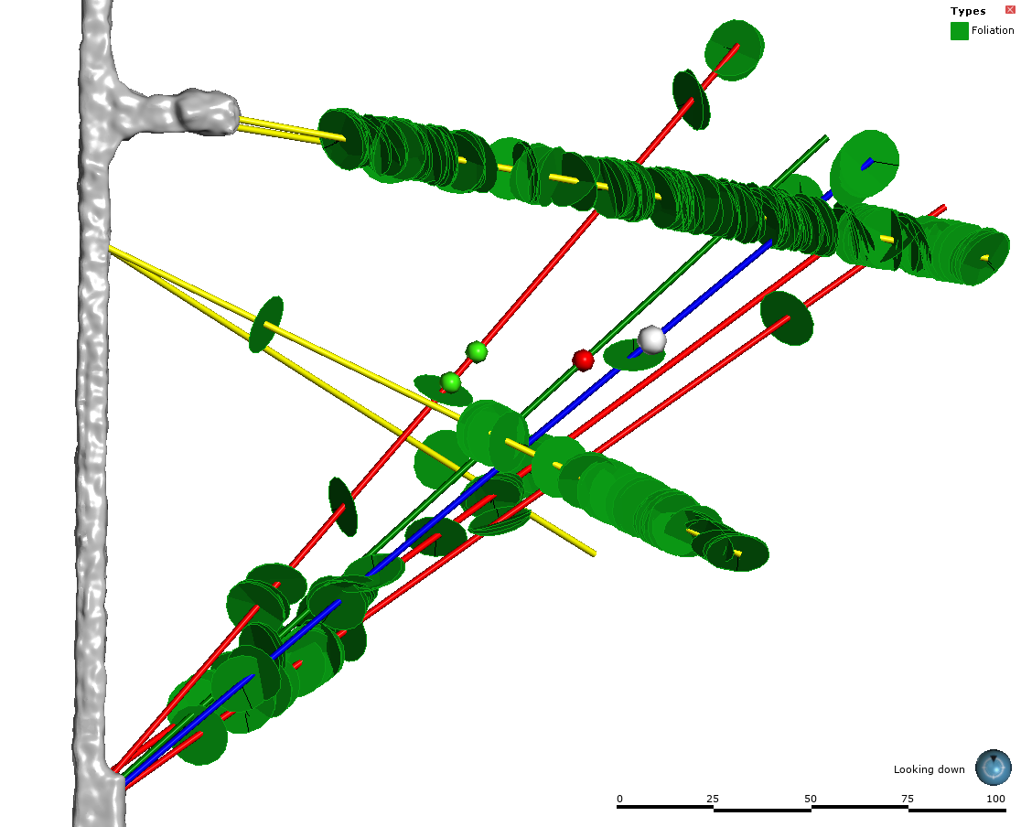
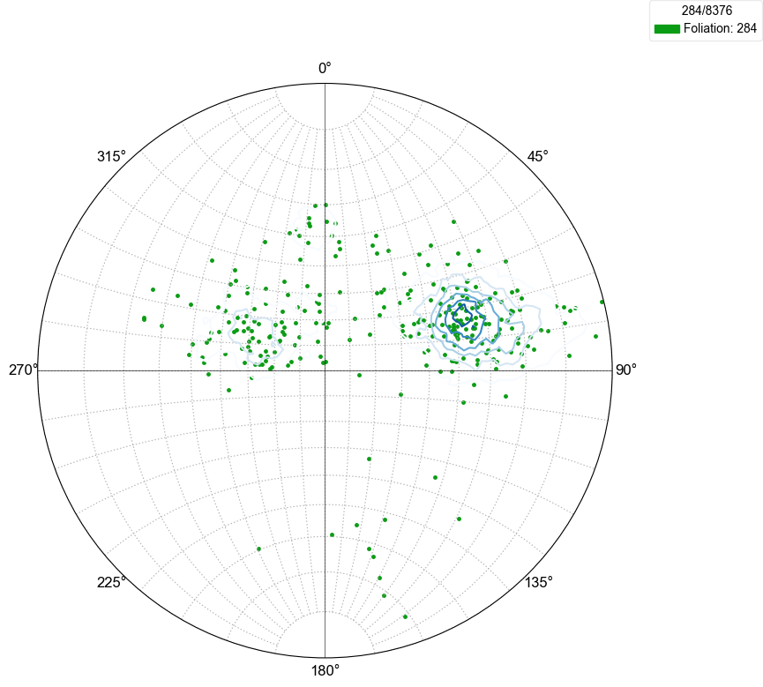
Foliations
A)
B)

Slide 5
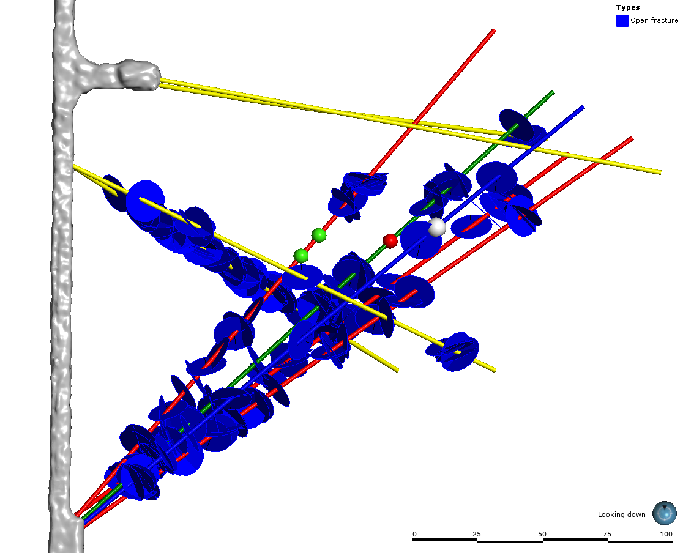
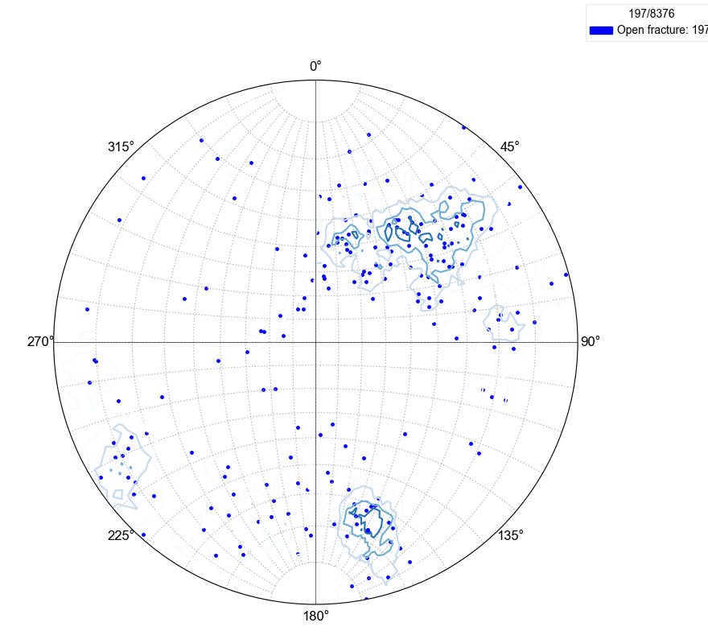
Open Fractures
A subgroup of open fractures similar to foliation-parallel large fractures (Figure 9A)
A subgroup of open fractures similar to tertiary (Figure 9A) and clay-soft layers (Figure xx)
A)
B)

Slide 6
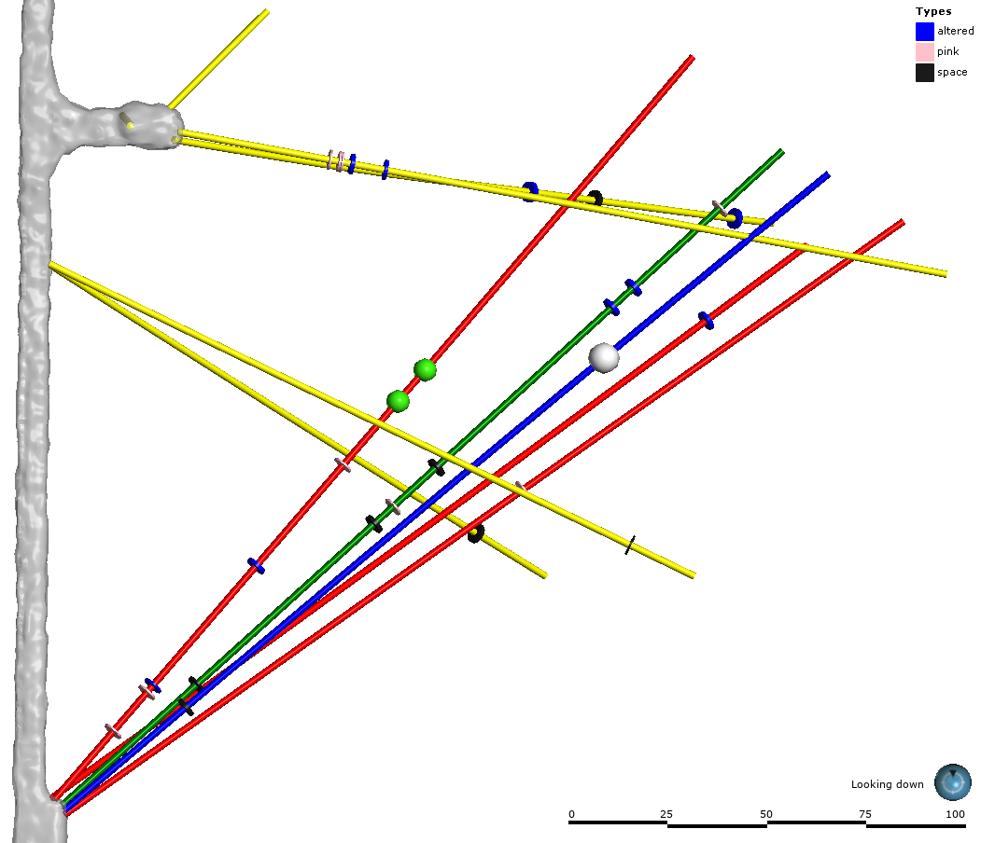
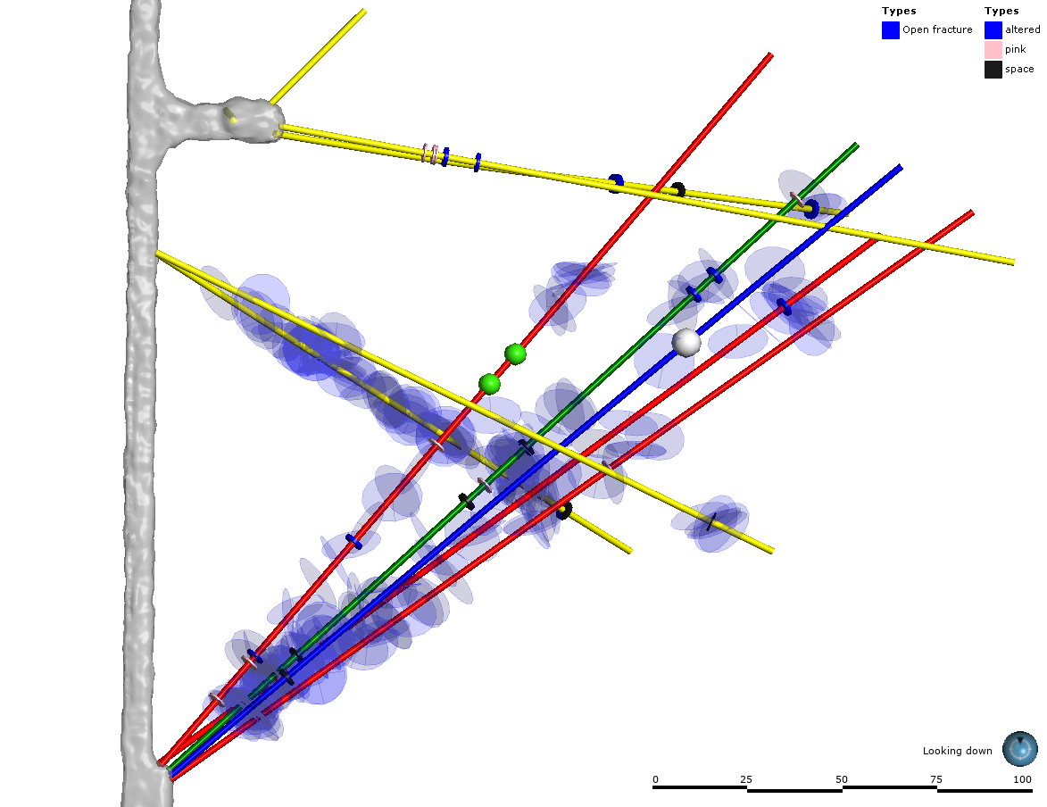
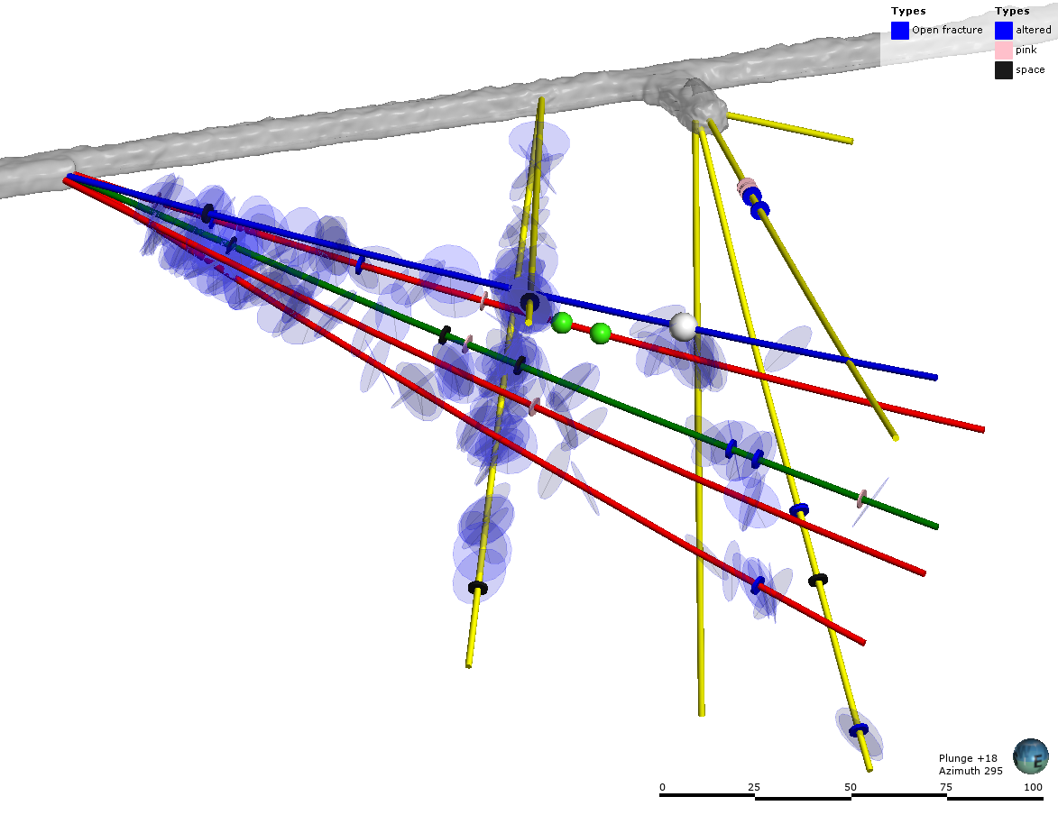
TH4100
TH4100
TN
TC
TN
TU
AML
TS
TC
TU
TL
AMU
AML
TL
AMU
TN production points
TU injection point
TS
DMU
DML
B)
TH4100
DMU
DMU
DML
AMU
TU
TN
TL
TC
TS
DML
AML
C)
TV4100
A)

Slide 7
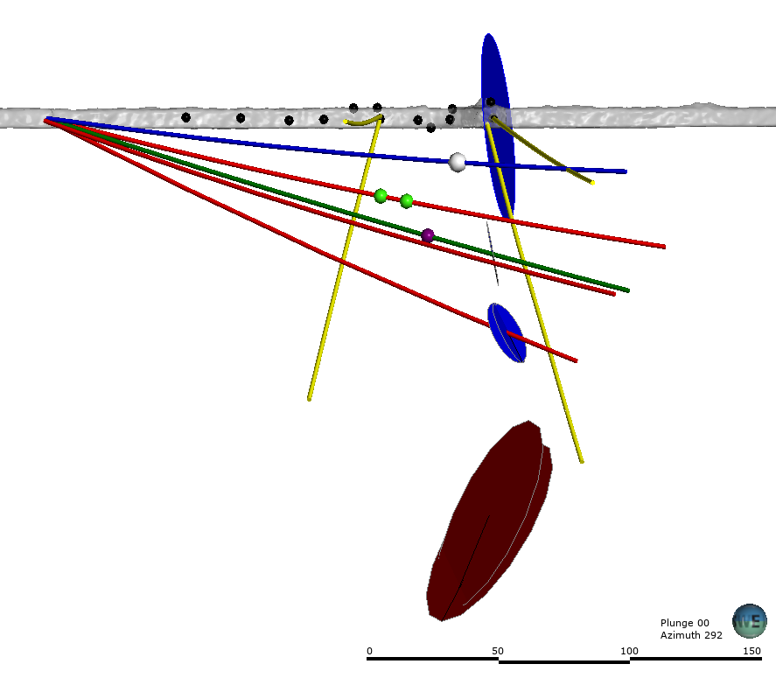
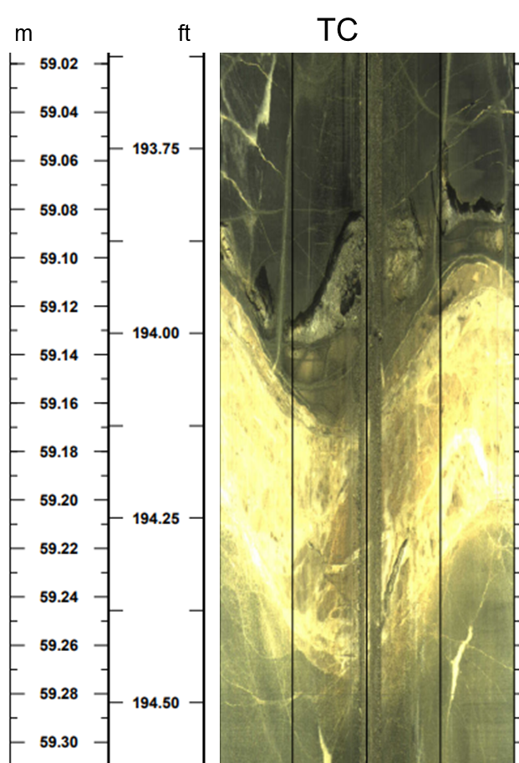
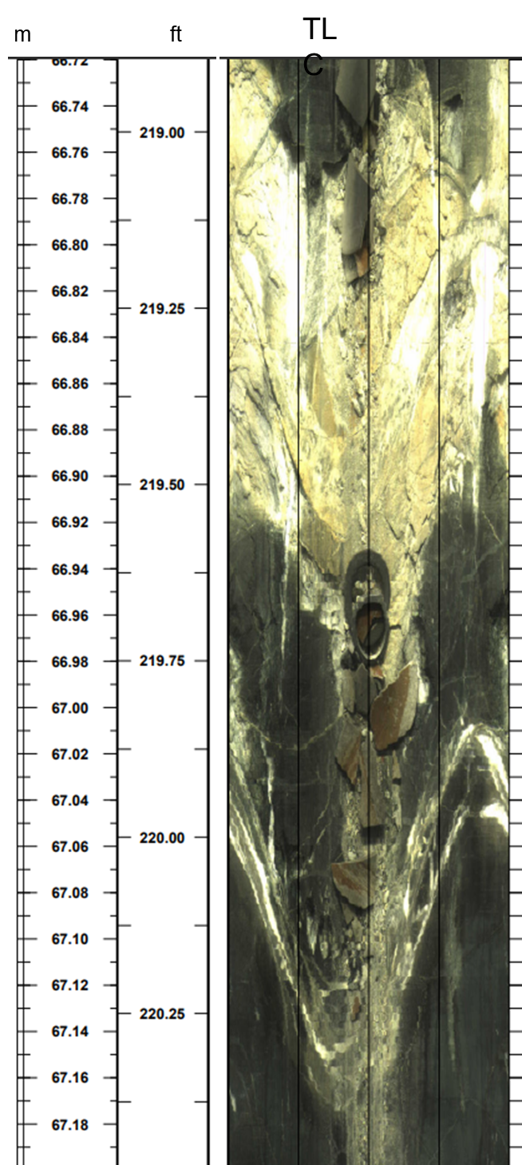
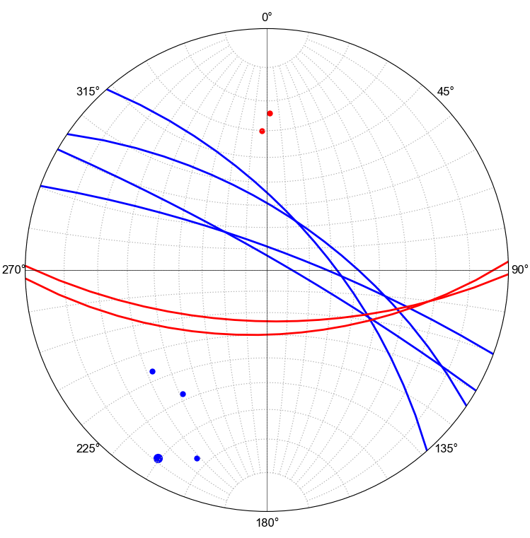
TV4100 HF, Tertiary fracture (drift), and TC-TL soft-clay layers
A)
Tertiary/clay-soft layers
Leak points
B)
DMA
TU
AMU
TU injection
TN
TC injection
TN production points
TC
Tertiary/clay-soft layers
TS
DML
AML
HF (TV4100)
HF (TV4100)

Slide 8
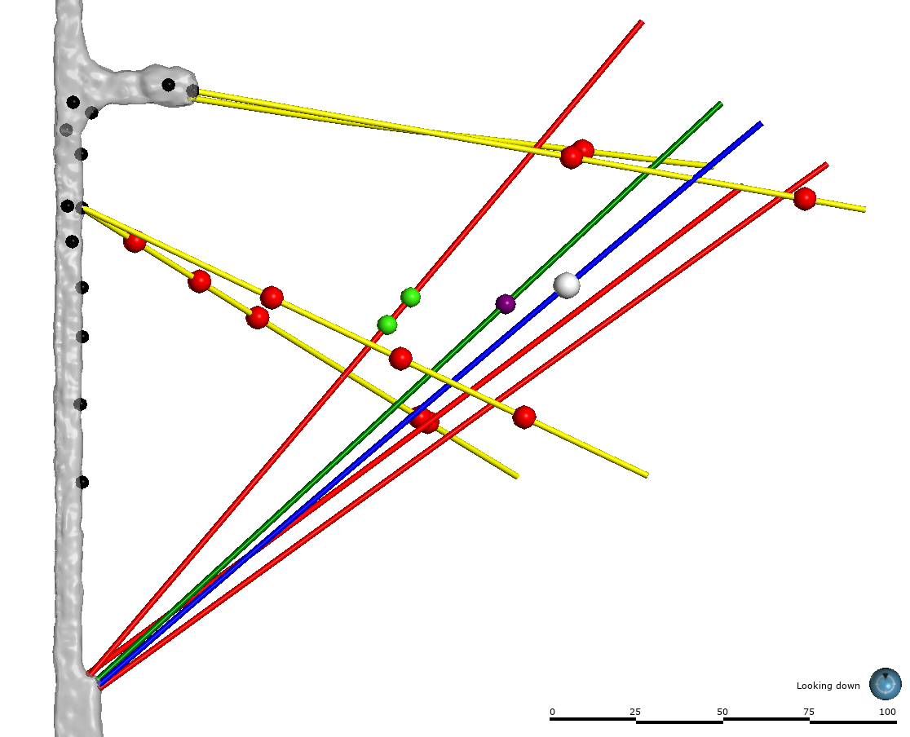
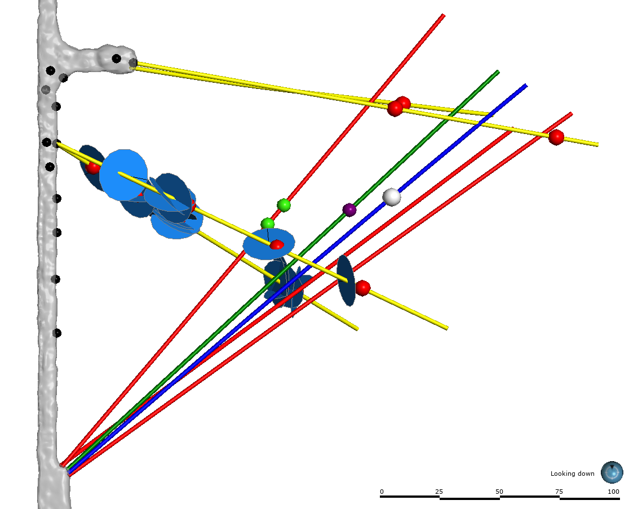
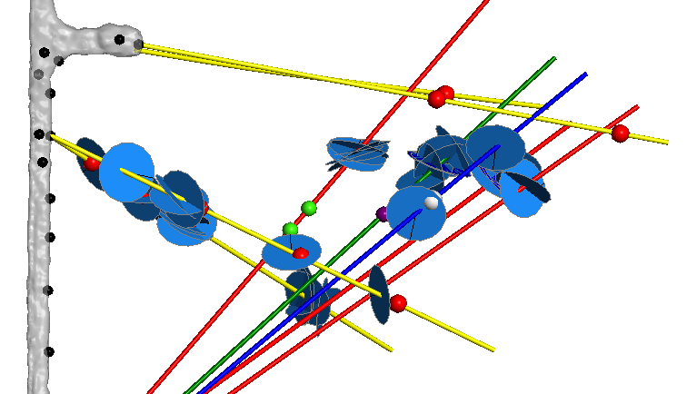
DTS anomalies and Open Fractures
TN
Leak points
TC
TU
AML
TS
TN production points
TL
TC injection
DTS anomaly points
TN
TU injection
TC
Leak points
AML
TU
TS
DML
DMU
AMU
AMU
TL
TN
TC
DMU
Leak points
AML
TU
TS
A)
DML
TL
AMU
DMU
DML
B)
C)

Slide 9
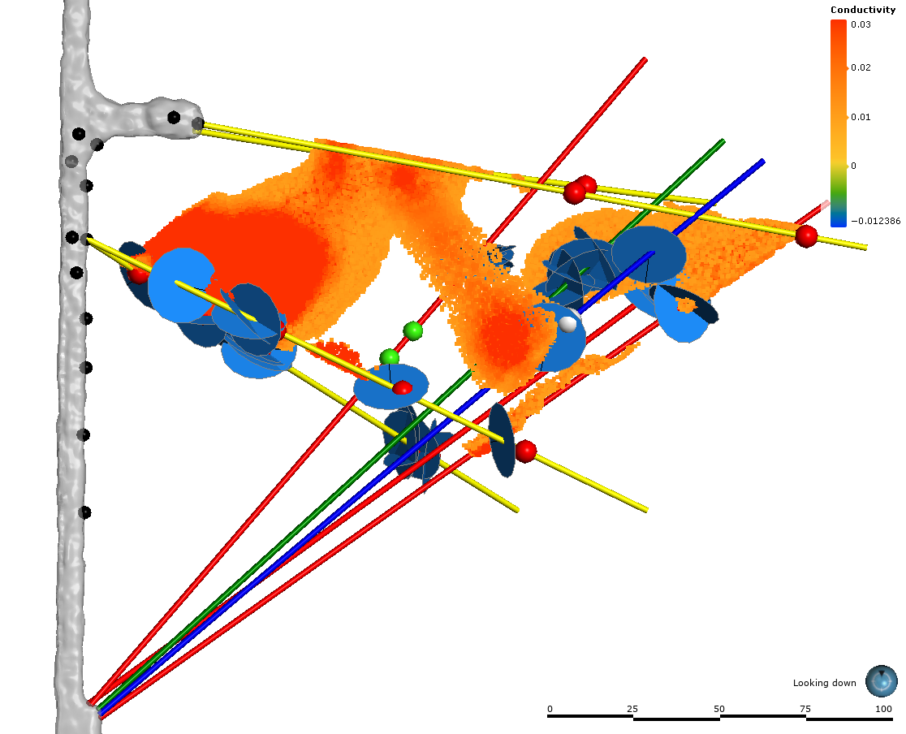
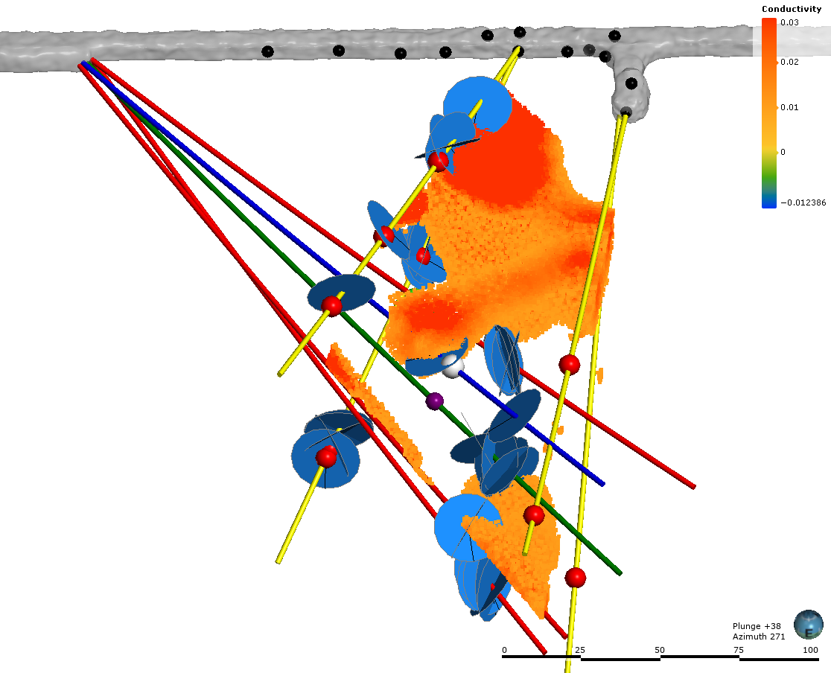
ERT and Open Fractures
TN
TC
TU
AML
AMU
AMU
TL
TS
DML
AML
DMU
TN
DML
DML
TU
TC
B)
TL
TS
A)

Slide 10
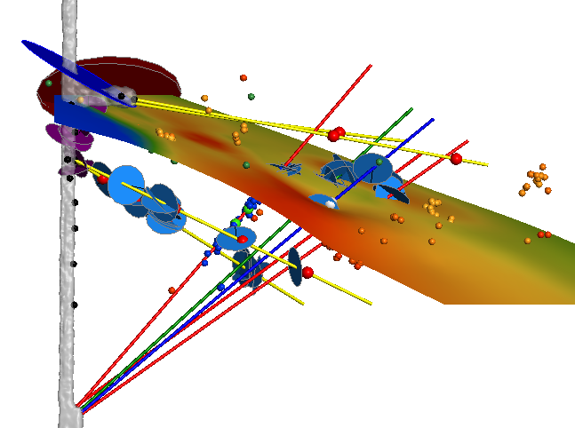
MEQ and Fracture zones
TN
TC
TU
AML
TL
AMU
TS
Open fractures
DML
DMU
Activated fracture zone with ~ orientation of Tertiary fracture and clay-soft layers (Figure 16A).

Slide 11
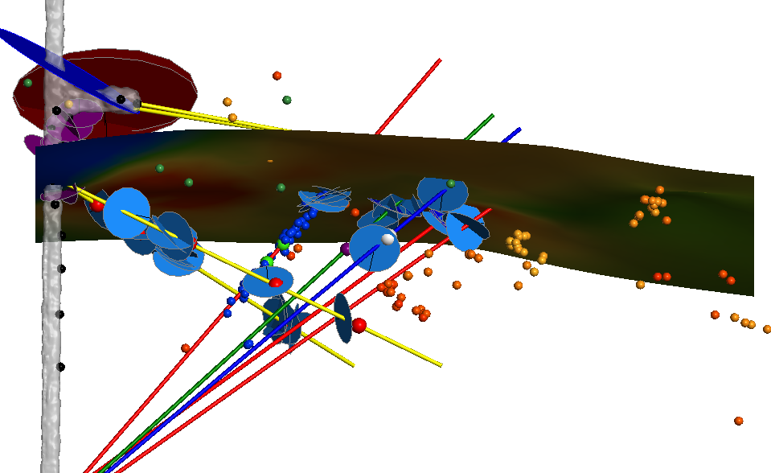
MEQ and Fracture zones
TN
AMU
TC
Activated fracture zone with ~ orientation of TV4100 hydraulic fractures.
AML
TU
TL
DML
DMU
TS

Slide 12
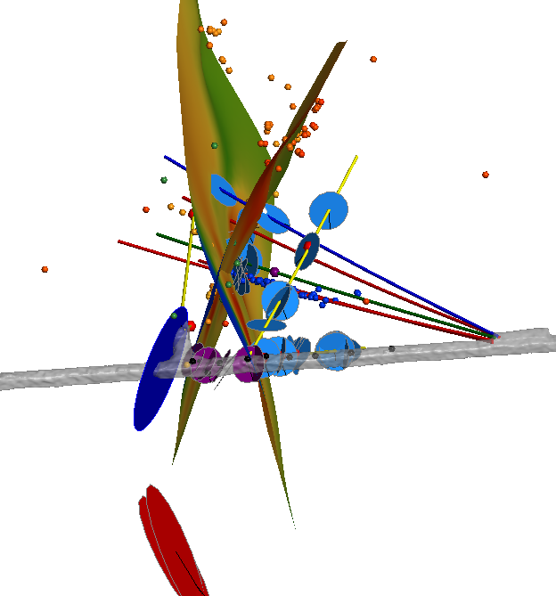
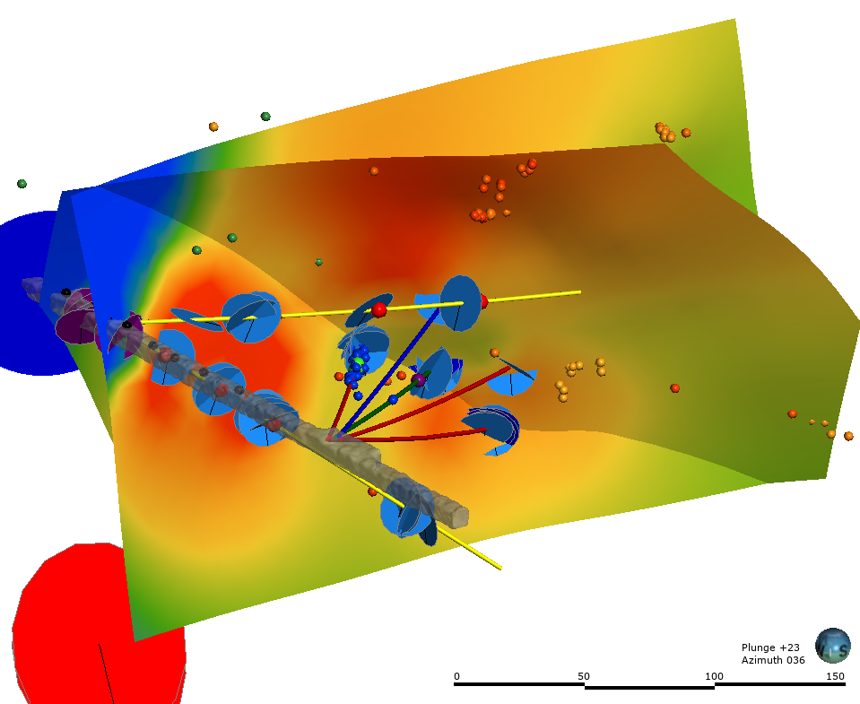
MEQ and Fracture zones

Slide 13
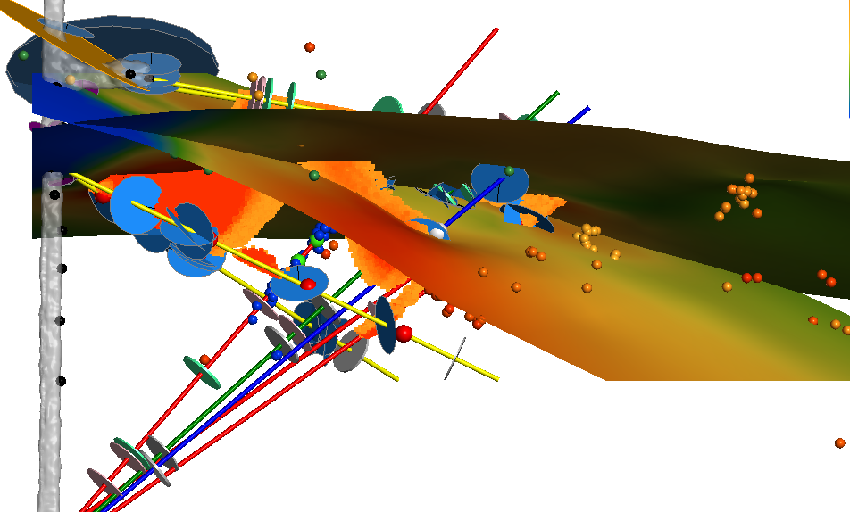
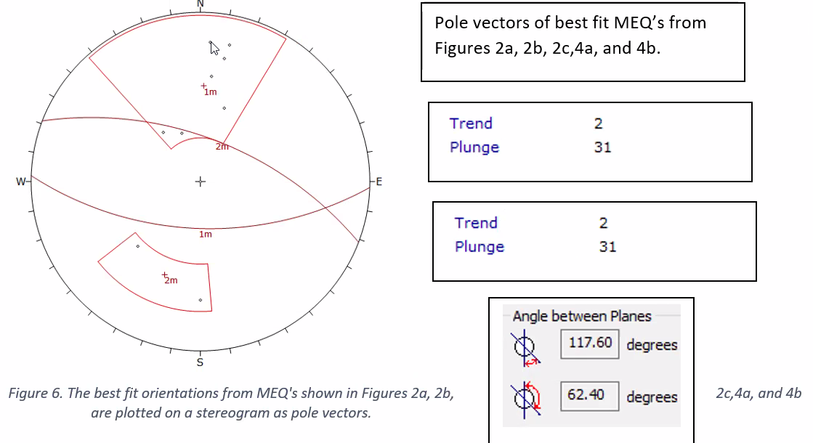
Fracture zones
Tertiary/clay-soft layers
TN
Activated fracture zone with ~ orientation of TV4100 hydraulic fractures.
TN
HF (TV4100)
Open fractures
Activated fracture zone with ~ orientation of Tertiary fracture and clay-soft layers (Figure 16A).
Bill’s MEQ interpretation (2/13/23)

